Slide 1

Switch Interfacing in PIC16F877A

Slide 2
What is a Switch?
A Switch is a device which is designed to interrupt the current flow in a circuit. In simple words, a Switch can make or break an electrical circuit. Every electrical and electronics application uses at least one switch to perform ON and OFF operation of the device.
So, switches are a part of the control system and without it, control operation cannot be achieved. A switch can perform two functions, namely fully ON (by closing its contacts) or fully OFF (by opening its contacts).
When the contacts of a switch are closed, the switch creates a closed path for the current to flow and hence load consumes the power from source. When the contacts of a switch are open, no power will be consumed by the load

Slide 3
Types of Switches
Basically, Switches can be of two types. They are:
Mechanical
Electronic
Mechanical Switches are physical switches, which must be activated physically, by moving, pressing, releasing, or touching its contacts.
Electronic Switches, on the other hand, do not require any physical contact in order to control a circuit. These are activated by semiconductor action.

Slide 4
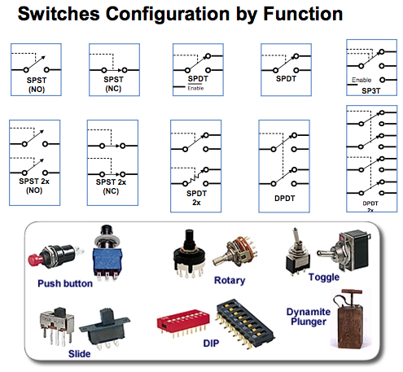
Mechanical Switches
Mechanical switches can be classified into different types based on several factors such as method of actuation (manual, limit and process switches), number of contacts (single contact and multi contact switches), number of poles and throws (SPST, DPDT, SPDT, etc.), operation and construction (push button, toggle, rotary, joystick, etc.), based on state (momentary and locked switches), etc.

Slide 5
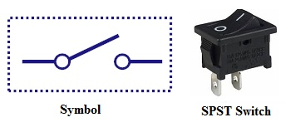
Single Pole Single Throw Switch (SPST)
This is the basic ON and OFF switch consisting of one input contact and one output contact.
It switches a single circuit and it can either make (ON) or break (OFF) the load.
The contacts of SPST can be either normally open or normally closed configurations .

Slide 6
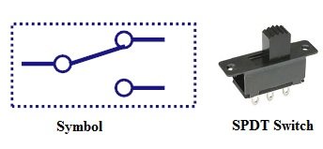
Single Pole Double Throw Switch (SPDT)
This switch has three terminals: one is input contact and remaining two are output contacts.
This means it consist two ON positions and one OFF position.
In most of the circuits, these switches are used as changeover to connect the input between two choices of outputs.
The contact which is connected to the input by default is referred as normally closed contact and contact which will be connected during ON operation is a normally open contact.

Slide 7
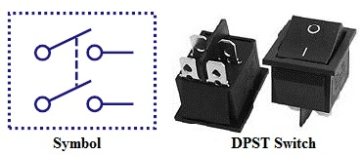
Double Pole Single Throw Switch (DPST)
This switch consists of four terminals: two input contacts and two output contacts.
It behaves like a two separate SPST configurations, operating at the same time.
It has only one ON position, but it can actuate the two contacts simultaneously, such that each input contact will be connected to its corresponding output contact.
In OFF position both switches are at open state.
This type of switches is used for controlling two different circuits at a time.
Also, the contacts of this switch may be either normally open or normally closed configurations.

Slide 8
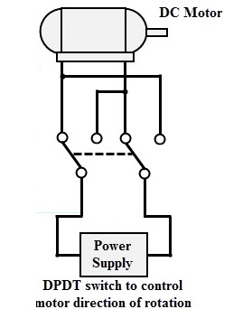
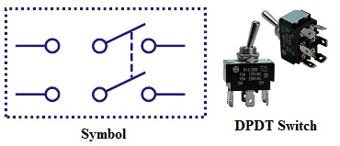
Double Pole Double Throw Switch (DPDT)
This is a dual ON/OFF switch consisting of two ON positions.
It has six terminals, two are input contacts and remaining four are the output contacts.
It behaves like a two separate SPDT configuration, operating at the same time.
Two input contacts are connected to the one set of output contacts in one position and in another position, input contacts are connected to the other set of output contacts.

Slide 9
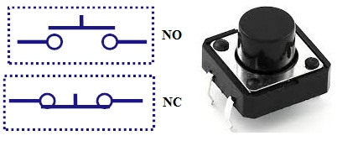
Push Button Switch
It is a momentary contact switch that makes or breaks connection as long as pressure is applied (or when the button is pushed).
Generally, this pressure is supplied by a button pressed by someone’s finger.
This button returns its normal position, once the pressure is removed.
The internal spring mechanism operates these two states (pressed and released) of a push button.
It consists of stationary and movable contacts, of which stationary contacts are connected in series with the circuit to be switched while movable contacts are attached with a push button.
Push buttons are majorly classified into normally open, normally closed and double acting push buttons as shown in the above figure.
Double acting push buttons are generally used for controlling two electrical circuits.

Slide 10
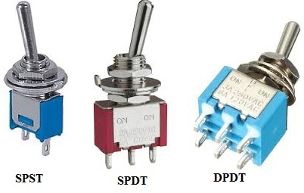
Toggle Switch
A toggle switch is manually actuated (or pushed up or down) by a mechanical handle, lever or rocking mechanism. These are commonly used as light control switches.
Most of these switches come with two or more lever positions which are in the versions of SPDT, SPST, DPST and DPDT switch. These are used for switching high currents (as high as 10 A) and can also be used for switching small currents.
These are available in different ratings, sizes and styles and are used for different type of applications. The ON condition can be any of their level positions, however, by convention the downward is the closed or ON position.

Slide 11
Push Button Interfacing with PIC16F877A

Slide 12
Push Button Interfacing with PIC16F877A
Push-button or simply button is a switch used mainly as a control device in many of the Embedded applications.
Push-button switches are mechanical switches.
Push-button switches are of two types push to on and push to off switches.
Push-button switches open and closes the contact between two ends of a line and returns two to the default state when released.
It is used as an input device, by connecting it to a pin of the microcontroller which is configured as an input.
The button is connected to the IO pin such that it can change the state of the controller pin(high or low)when it is pressed.

Slide 13
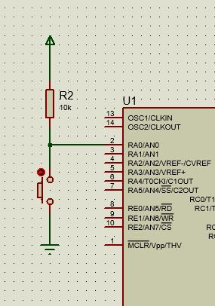
Pull up mode
The microcontroller pin is connected to Vcc through a pull-up resistor. It is also connected to ground through a push-button switch.
When the switch is pressed the pin will be connected to ground and thus the voltage will drop to zero. This change can be verified in firmware if the above-mentioned pin is configured as an input.

Slide 14
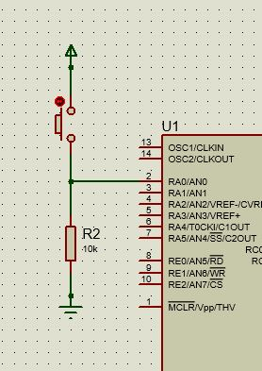
Pull down mode
The pin will be connected to ground by default and it reads a logic zero when not pressed. When the key is pressed the pin reads a logic high.

Slide 15
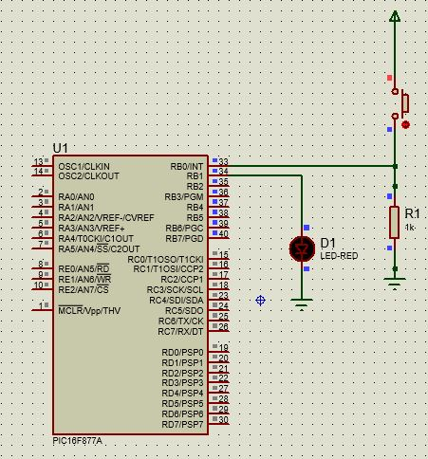
Led with On/Off push button

Slide 16
Program for switch interface
#include<pic.h>
void delay()
{
int i;
for(i=0;i<20000;i++);
for(i=0;i<20000;i++);
}
void main()
{
TRISB = 0b00000001;
PORTB = 0x00;
while(1)
{ if(PORTB & (1<<0))
{
PORTB = (1<<1);
delay();
}
else
{
PORTB = (0<<1);
}
}
}

Slide 17
Heading
contents

